Slide 1


Sales Performance Analysis for Better Business Decisions
Date
5 / 12 / 2025
Supervised by:
Eng. Waleed Mohammed
By: Limitless Insights
Turning Raw Data into Actionable Insights

Slide 2

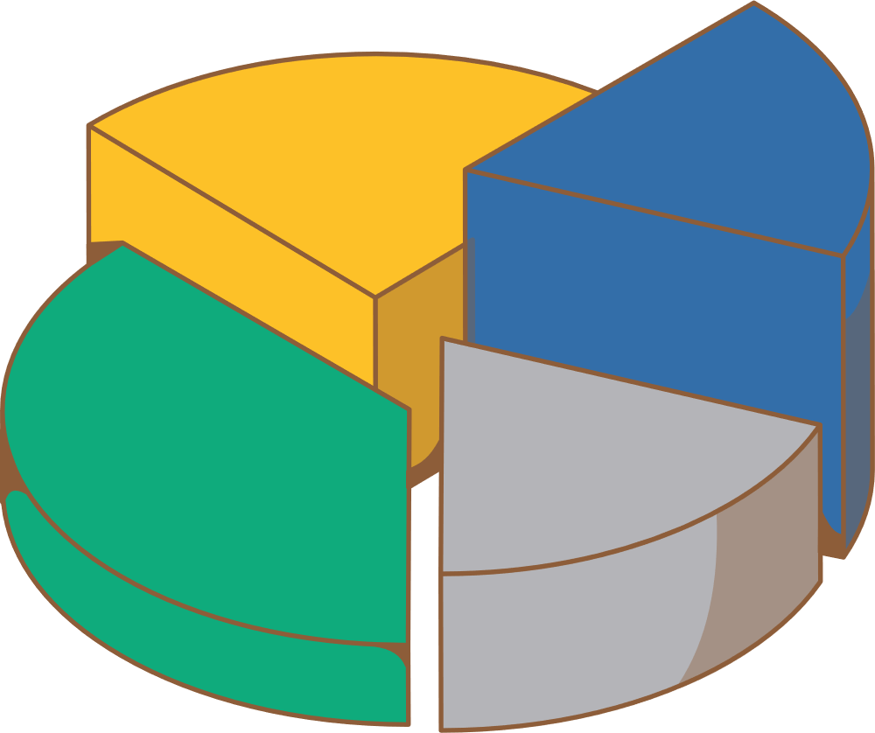
Meet the team!
Basant
Kareem
SQL Queries & KPIS
Team Leader
Data Cleaning
Mohammed
Eman
Data Modeling Structure
PowerBI Dashboard
A full-stack data analysis team handling data collection, cleaning, database building, advanced SQL analysis, and Power BI dashboard development to deliver actionable insights.

Slide 3

Project Idea and Goal
Core Idea
Comprehensive analysis of sales data to determine current market performance and identify future growth trends
Main Goal
Provide actionable insights to help decision-makers assess market evolution, identify seasonal and regional patterns, and optimize pricing and inventory strategies
Sub-Goals
Assess market size and sales volume
Determine regional and local sales performance

Slide 4





Project cycle
Data structuring
Creating the database and Sales table with required structure and all necessary columns
Visualization
Data Preparation
Creating an interactive dashboard using PowerBI
Loading data from the CSV file into a MySQL after creating the database for Cleaning
Charts, tables, and visual performance indicators
Analysis
File: Different Store.csv
Applying advanced SQL queries to calculate key performance indicators
Calculating margins, revenues, regional performance, and seasonality

Slide 5
Data Cleaning and Preparation Process
Ensuring Data Quality and Reliability
Raw Data Issues
Clean Data Solutions
✕
Inconsistent category naming and formatting
✓
Checked missing values with appropriate strategies
✕
Incorrect or mixed data types
✓
Checked duplicate records and validated uniqueness
✓
Standardized all category values and naming conventions
✓
Converted fields to correct data types (numeric, date, text)
Tools & Technologies Used
SQL
Power Query
Impact
The cleaning process transformed raw, inconsistent data into a reliable, structured source ready for advanced modeling and analysis. This ensures accuracy in all downstream KPI calculations and dashboard insights.

Slide 6
Dataset Overview
Core KPIs Researched
Revenue
Profit & Profit Margin
Sales by Region
Sales by Category
Customer Segments
Order Priority
Dataset Overview
Source
Data Scope
Multi-dimensional
Different_stores_dataset
Transactions across regions, states, and shopping malls

Slide 7


Key Performance Indicators (KPIs)
These KPIs guided the analysis and shaped our dashboard’s structure
Sales Performance KPIs
Profitability & Margin KPIs
Total Sales Revenue
Sales by Region
Average Order Value (AOV)
Average Value per Region
Total Profit
Gross Profit Margin (GPM)
Profit per Transaction
Category Profitability
Product & Category KPIs
Geographic Performance KPIs
Total Customers
Profit By Shopping mall
Sales By Region
Avg Transaction per region
Top-Selling Category
Category Revenue Contribution
Average Selling per Category
Average Markup per Category

Slide 8
Core SQL Queries
SQL-Driven Analysis
Why SQL?
• Extract and structure raw data for analysis
• Join tables (Sales, Products, Customers, Regions)
• Perform aggregations and calculated metrics (profit, margin, AOV)
• Prepare clean views/tables for Power BI modeling
Category Profitability
Total Sales Revenue
SELECT category, SUM(profit) AS total_profit FROM sales GROUP BY category ORDER BY total_profit DESC;
SELECT SUM(selling_price_per_unit * quantity) AS total_sales_revenue FROM sales;
Regional Sales
Gross Profit Margin
SELECT region, SUM(revenue) AS total_revenue FROM sales GROUP BY region ORDER BY total_revenue DESC;
SELECT ROUND(
(SUM(profit) / SUM(revenue)) * 100, 2)
AS profit_margin_percent FROM sales;

Slide 9
Star Schema Architecture
Data Model Design
Fact Table
FactSales
invoice_no ,quantity, selling_price, cost_price Keys: date, customer, product, location, payment
Dimension Tables
DimCustomer
DimDate
customer_id, age, gender, demographics
date_key, full_date, year, month, quarter
DimProduct
DimLocation
product_key, category, subcategory
location_key, region, state, shopping_mall
Why Star Schema?
Simplifies complex queries, improves dashboard performance, and ensures consistency across all reports.

Slide 10
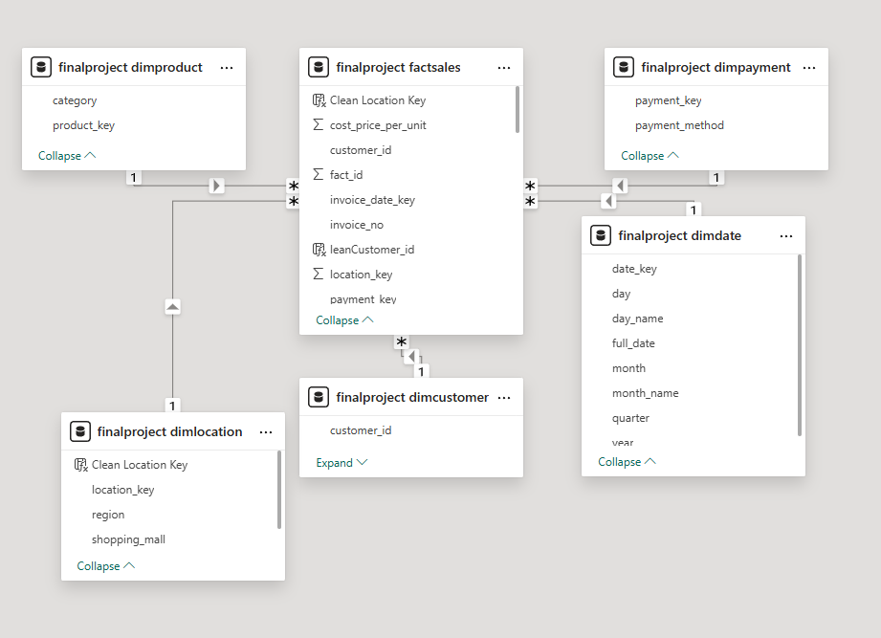
Star Schema Architecture
Data Model Design

Slide 11


Exploratory data analysis
Key EDA Findings
1
2
3
4
5
Sales Trends Over Time
Product Category Distribution
Regional Revenue Comparison
Customer Behavior Patterns
Profitability Analysis
Clear seasonal patterns identified with peak sales during specific months, guiding marketing campaign timing.
Uneven distribution across categories;
top 3 categories account for 65% of total revenue.
Significant regional variation with
top-performing region generating
3x revenue of lowest-performing region.
Average transaction value varies by region and category, informing pricing and inventory strategies.
Some high-volume categories have low margins, indicating need for cost optimization or pricing adjustments.

Slide 12
Dashboard overview
Structure & KPIs
Designed for Decision-Makers: Real-time monitoring of sales performance with actionable insights at every level
Comprehensive Analysis
Interactive Elements
1
Category Analysis
Customer Analysis
Regional Analysis
Executive Summary
3
Dynamic date range filters
Region and category slicers
Drill-through capabilities
Comparative analysis tools
Primary KPIs Displayed
Market Analysis & Growth Trends
2
Total Sales Revenue
Total Profit
Gross Profit Margin (%)
Sales by Region
Sales by Category
4
Total Market Size
Seasonality and Cyclicality
Historical Growth
Strategic Value
Understanding these dimensions enables decision-makers to assess current market position and forecast future trends for improved planning and resource allocation

Slide 13
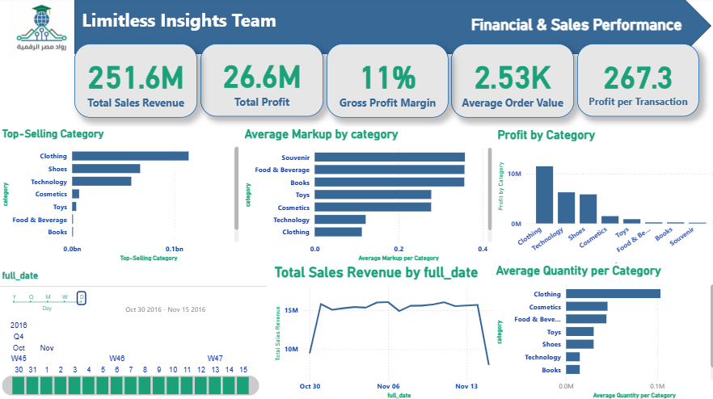
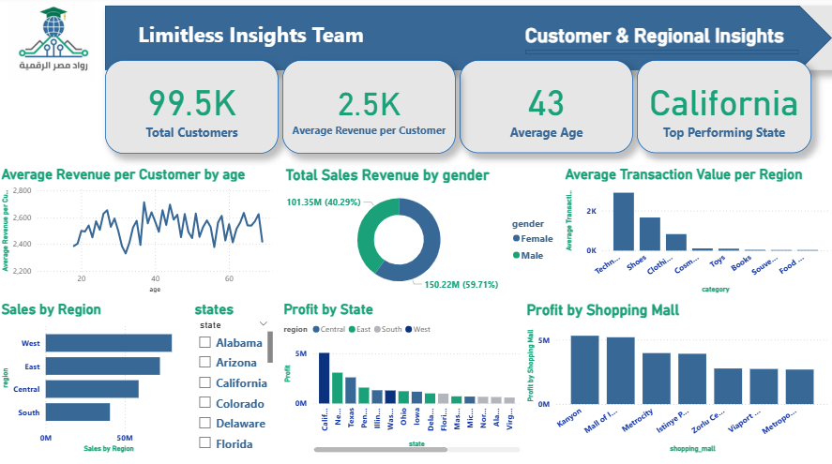
Dashboard overview
Key Metrics Displayed
Total Revenue
Gross Profit Margin
251.6M
11%
Total Profit
Avg Order Value
26.6M
2.53K
Dashboard Features
Top-Selling Category analysis by revenue
Average Quantity per Category
Profit by Category breakdown
Average Markup by category
Sales Revenue trend over time
Date slicer for dynamic filtering

Slide 14


Customer & Regional Insights
Avg Revenue per Customer
Total Customers
99.5K
$2.5K
Top Performing State
Avg Customer Age
43
California
Key Dashboard Components
Average Revenue per Customer by Age: Shows how customer spending varies across age groups
Average Transaction Value by region : the average amount spent per transaction in each region
Total Sales Revenue by Gender: Breakdown of revenue contribution by customer gender
Sales by Region: Revenue distribution across West, East, Central, and South regions
This dashboard enables stakeholders to understand customer segmentation by demographics and geography, identify high-value regions and locations, and optimize resource allocation based on regional performance and customer behavior patterns

Slide 15


Key Findings & Actionable Business Insights
Identified top-performing states and regions with the highest total profit. Certain geographic areas significantly outperform others, indicating strong market potential.
1
Strategic Discoveries from Data Analysis
Regional Profitability Leaders
Action: Allocate more resources and inventory to high-performing regions to maximize returns.
Category Performance Gaps
Pinpointed product categories with low profit margins and underperforming sales. Some categories are generating volume but not profitability.
2
Customer Loyalty Metrics
Action: Adjust pricing strategies or reduce costs for low-margin categories to improve profitability.
3
Analyzed repeat customer rates and average revenue per customer. Understanding customer lifetime value reveals retention opportunities.
These findings directly guide strategic decision-making, enabling managers to reallocate inventory, adjust pricing, and develop customer retention strategies with data-driven confidence.
Action: Develop targeted loyalty programs to increase repeat purchases and customer lifetime value.

Slide 16
Real-World Scenario
Manager's Workflow
1
2
3
4
Filter by Region
Spot Low Performance
Drill-Through Analysis
Take Action
Manager selects a specific region using the region slicer to focus analysis on that market.
Notices a product category with declining sales and low profit margin compared to other categories.
Clicks on the underperforming category to see average markup and quantity.
Based on insights, decides to adjust pricing, reduce costs, or reallocate inventory to improve performance.
Instant Update
Identify Problem
Uncover Causes
Make Decisions
Outcome: From problem identification to actionable decision in minutes, not days. The dashboard enables rapid decision-making and strategic action.

Slide 17
Future improvements
Scaling the Analytics Platform
Predictive trend forecasting using Machine Learning
Advanced Analytics
1
Predictive sales forecasting
ML-based demand planning
Anomaly detection algorithms
Advanced customer lifetime analytics
Customer Intelligence
2
Segmentation optimization
Customer Lifetime Value (CLV) model
Churn prediction analysis
Automated real‑time data insights
Data & Integration
3
Inventory & CRM integration
Marketing data integration
Automated data refresh pipelines
Mobile-friendly accessible dashboard
4
Enhanced accessibility features
User Experience
Executive mobile app
Mobile-friendly dashboard
Transform the analytics platform into a comprehensive, AI-powered intelligence system that enables real-time decision-making across the entire organization.

Slide 18

Turning
Raw Data
into
Actionable Insights
Thank You!
LIMITLESS INSIGHTS

